Slide 1
Innov8 2.0 Project satya
Omkar Bhandare
​​Rishit Garg
Parth Patil
Nived Shah

Slide 2

About the project
Satya's primary mission is to assist HR professionals in navigating the complex world of resumes, recommendation letters, and professional networks. By leveraging advanced AI techniques, Satya aims to uncover hidden patterns, verify credentials, and provide insightful analysis beyond surface-level information.

Slide 3
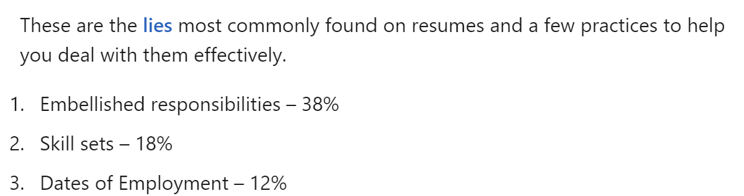
Fraud detection
Vague Phrases
Authenticity of LoRs
Identify phrases that overstate qualifications or show lack of experience
Check specificity of recommendation and flag use of embellished statements
Reciprocal Endorsements
Timeline Inconsistencies
Look for recursive endorsements to identify connections endorsing each other for competitive gain
Evaluate the continuity and progress in a candidate’s career.
LinkedIn

Slide 4
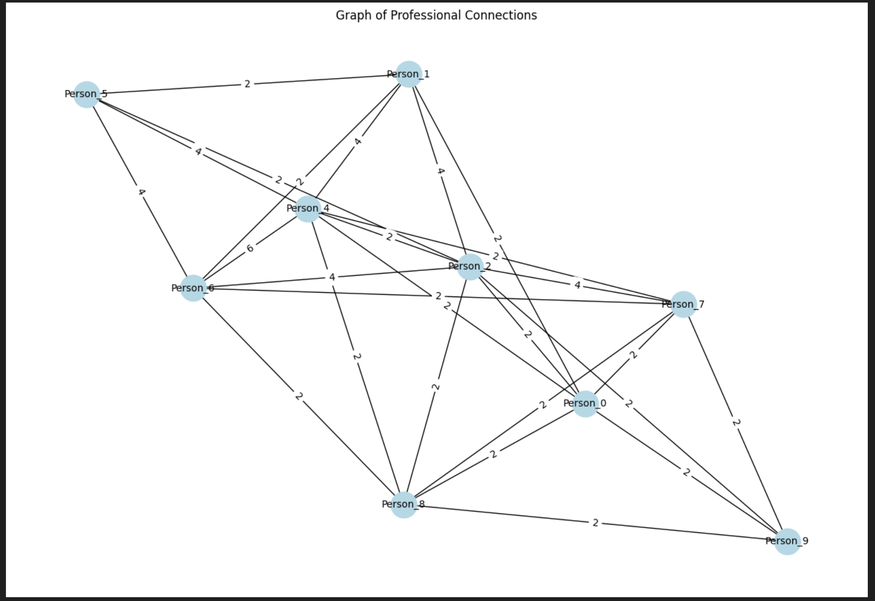
NETWORking analysis
Degree Centrality: Measures direct connections; individuals with a high degree of centrality are influential, well-connected, and can access information quickly.
Betweenness Centrality: Reflects how often someone bridges between others; high betweenness indicates control over information flow and cross-group collaboration.
Closeness Centrality: Indicates proximity to others in the network; high closeness means faster access to people and resources, aiding efficient communication.
Clustering Coefficient: Measures how tightly-knit a person’s connections are; high clustering suggests strong group relationships and potential team cohesion.

Slide 5




Solution
WHY SATYA
WHAT IT DOES
FOR WHOM
IMPACTS
Organizations face significant risks from fraudulent claims, which can lead to poor hiring decisions and impact overall team performance.
Employ robust algorithms to scrutinize Resumes and identify fraud indicators. Provide an easy-to-use interface for screening and ranking candidates.
A large-scale platform targeting efficiency and authenticity in the hiring process via HRs and providing candidates with a fair opportunity to get ranked in their job applications.
Reduce risk of frauds, enhance hiring quality, improve team dynamcis, reduce valuable time-consuming process of manual screening.

Slide 6
WHY SATYA
Companies face significant risks from fraudulent claims in Resumes, which can lead to poor hiring decisions and impact overall team performance.

Slide 7
WHAT IT DOES
Employ robust algorithms to scrutinize Resumes and identify fraud indicators. Provide an easy-to-use interface for screening and ranking candidates.

Slide 8
FOR WHOM
A platform targeting efficiency and authenticity in the hiring process for assisting HRs, and providing candidates with a fair opportunity to get ranked in their job applications.

Slide 9
IMPACT
Reduce risk of frauds, enhance hiring quality, improve team dynamics, reduce valuable time-consuming process of manual screening.

Slide 10
HR DASHBOARD - INSIGHTS
An interactive dashboard for HRs to
View Resume Scores of candidates at a glance
Compare candidates with each other
Define Job Application domains​

Slide 11
TECHNICAL Overview

Slide 12
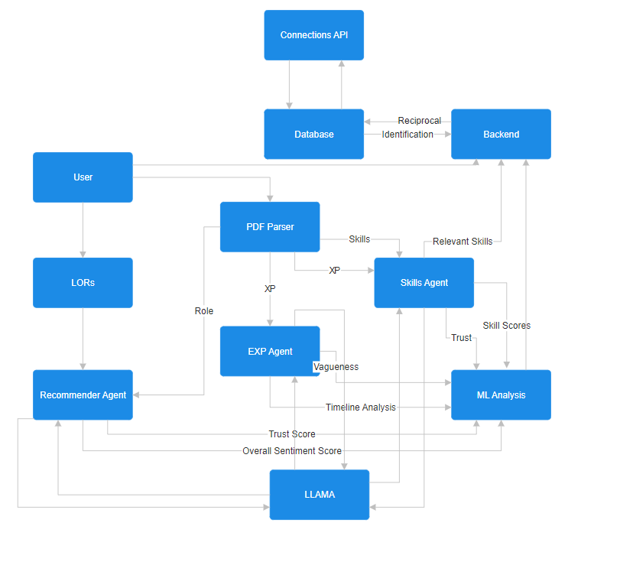
PROCESS FLOWCHART

Slide 13
Scalability/optimization
How we’ll scale in the future
Step 1
Step 2
Step 3
System rollout to handle increasing volumes of data without compromising performance
Continuous updates to inculcate the emerging hiring market trends, predictive modelling to anticipate future skills
The use of more sophisticated AI models provides more accurate results without time compromises​

Slide 14
Summary
At Contoso, we believe in giving 110%. By using our next-generation data architecture, we help organizations virtually manage agile workflows. We thrive because of our market knowledge and great team behind our product. As our CEO says, "Efficiencies will come from proactively transforming how we do business."​

Slide 15
Thank you
Mirjam Nilsson​​
206-555-0146​
mirjam@contoso.com​
www.contoso.com​

